Slide 1
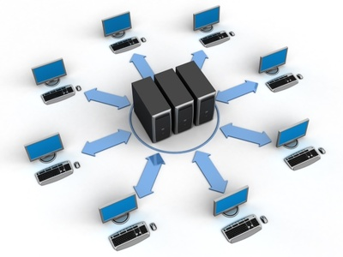
Network Fundamentals
Network fundamentals part 3

Slide 2

Objectives:
An overview over network topologies.
Major roles of some infrastructure components.

Slide 3
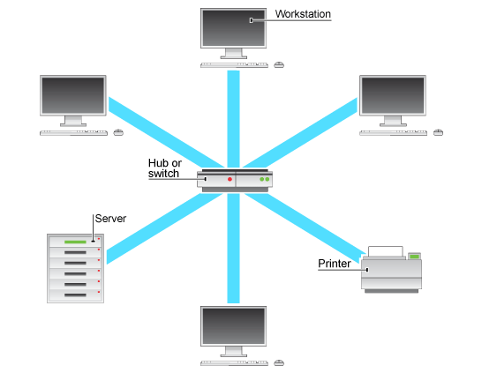
An overview over network topologies:
Star
Mesh
Hybrid

Slide 4
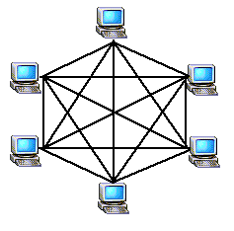
An overview over network topologies:
Star
Mesh
Hybrid

Slide 5
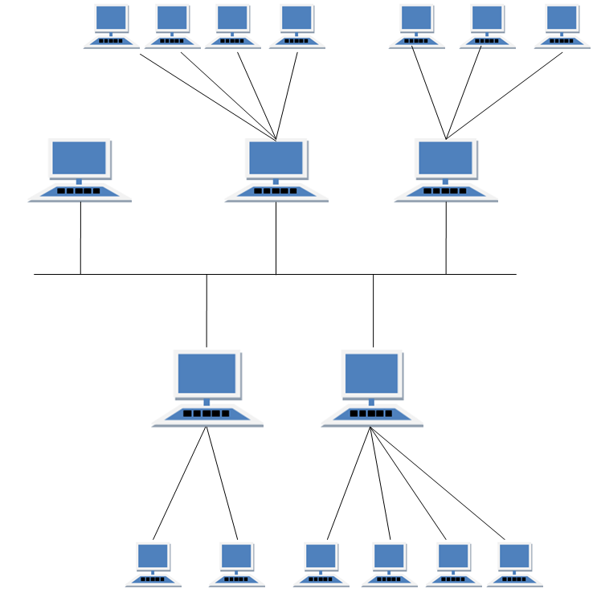
An overview over network topologies:
Star
Mesh
Hybrid

Slide 6
An overview over network topologies:
Star
Mesh
Hybrid

Slide 7
Major roles of some infrastructure components:
Firewall
Access Point
Wireless Controller

Slide 8
Objectives:
An overview over network topologies.
Major roles of some infrastructure components.

Slide 9
CCNA Routing & Switching
Network fundamentals part 3

